Slide 1

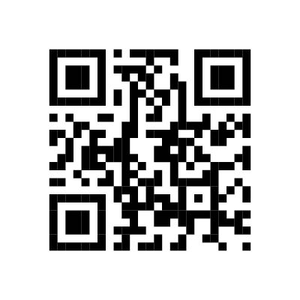
Myuhc.com
Notes:
Thank you for joining us today. In today’s presentation, we are going to go through all the features of myuhc.com and the UHC App.
If you would like to follow along, simply scan the QR Code to open myuhc.com.

Slide 2
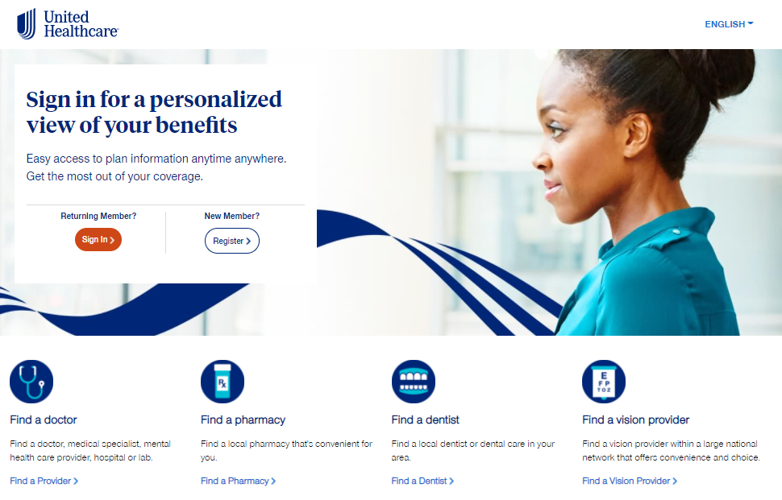
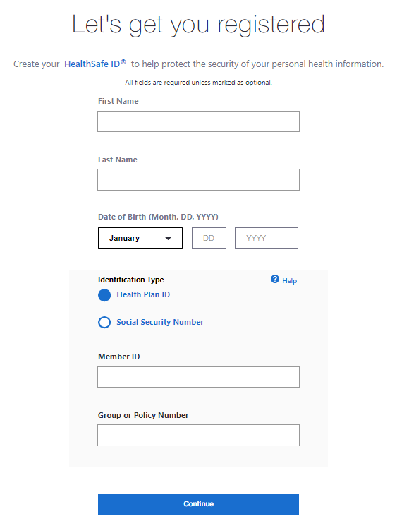
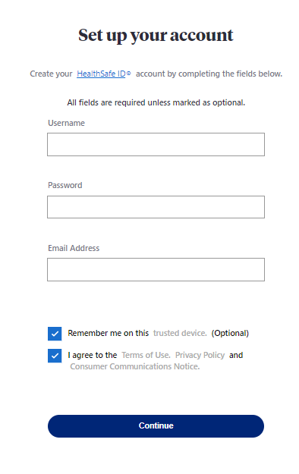
Activate your myuhc.com account
Go to www.myuhc.com Click on “Register” under New Member? | Complete this page by using your UHC Medical ID card | Create your HealthSafeID Create a unique username Create a password Enter your email address
Notes:
Let’s begin by going to www.myuhc.com.
Click on “Register” under New Member?
On the next page, you will need your UHC Medical ID card.
Enter your name and date of birth. Then, enter your member ID number which can be found in the upper left hand corner of your ID card. Then enter the group number which is the number in the upper right hand corner of your ID card.
Select Continue
Now you are going to create a unique username and password called your HealthSafeID. Enter your email and select continue.

Slide 3
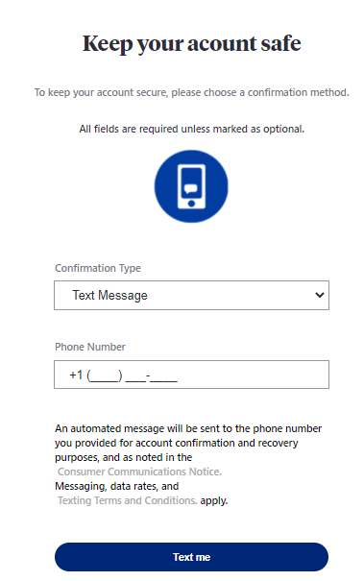
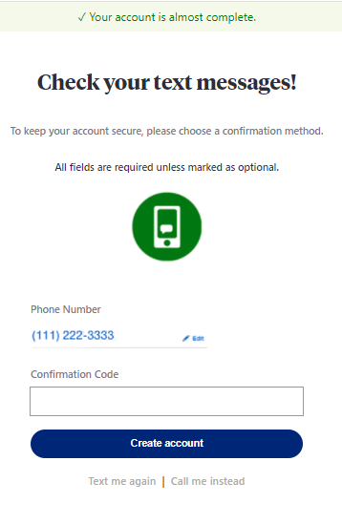
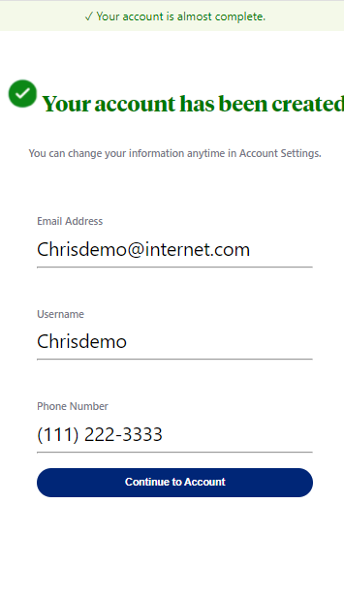
Activate your myuhc.com account continued
Enter your personal cell phone Select Text me | Check your text message and enter the confirmation code below. Select Create account | Congrats! Your account has been created. Select Continue to Account to enter myuhc.com
Notes:
Now that you have created your HealthSafeID, we are going to confirm your account set-up.
Enter your personal cell phone
Select Text me
Check your text messages and enter the confirmation code below on the next page
Congrats! You have created your HealthSafeID which you will use to login to myuhc.com and the UHC App.
Select Continue to Account to enter myuhc.com

Slide 4
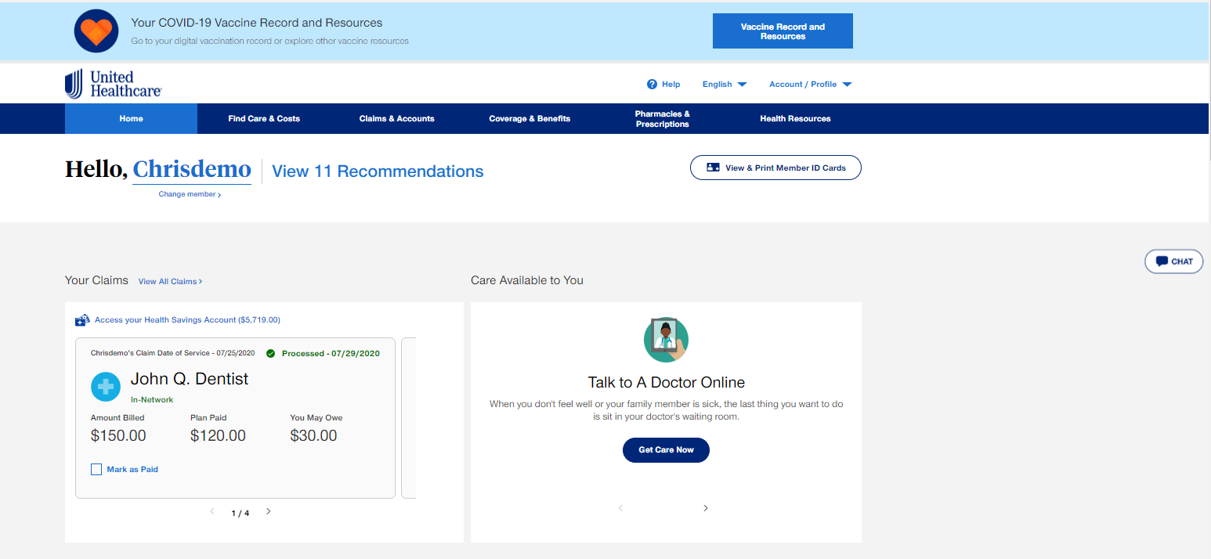
Dashboard
COVID-19 Resources
Account Settings
Toolbar
View, Print and Order ID Cards
View recent claims
Connect with a 24/7 Virtual Doctor
Chat
with an Advocate
Notes:
On the dashboard, you can find many resources. We will outline those now. Please note, this screen may vary slightly from the slides based on your medical plan.
At the top of screen, you will find COVID-19 resources. The page will provide information on how to submit a claim for an at-home kit you purchased, FAQs about at-home kits, testing locations near you and much more.
Above the blue tool bar, you will find your Account Settings. If you receive a message from UHC, it will appear in this section.
The blue toolbar allows you to quickly go to each section within myuhc.com. Click on any of the titles and you will be taken to that section.
If you ever need a new ID card or an extra one, you can click on View & Print Member ID Cards.
UHC allows our members to chat and email with our member services team. You can quickly chat with an Advocate by clicking on the chat button from the home screen.
Your most recent claims will appear here on the home screen. You can scroll through these to view each one or click on the claim to view the details.
24/7 virtual care is very popular, You can click here and quickly be connected with one of our virtual providers.
Next, we will explore each section within myuhc.com.

Slide 5
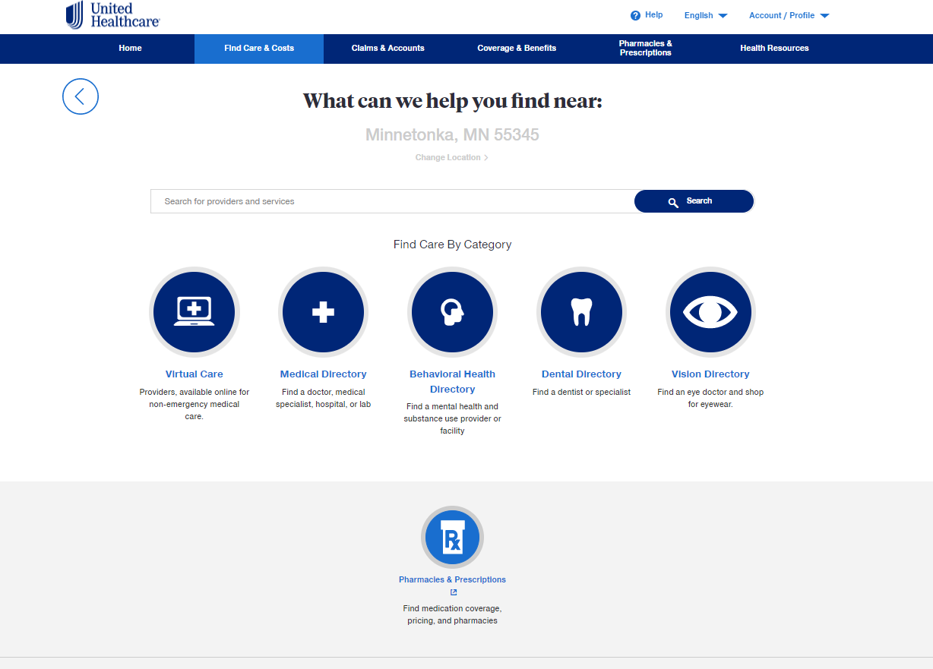
Find Care & Cost
Confirm city and state
Search by provider name, practice or services
Quick search by category
Notes:
Finding the care you need and knowing your costs ahead of time is easier than ever on myuhc.com under the Find Care & Costs tab. In just a few simple steps, you can find a doctor, clinic, hospital or lab that meets your needs.
Using multiple search options, you can filter results by location, specialty, quality, cost, services offered and more. You can even see patient ratings.
Start your search by confirming the city and state. If you would like to see a provider in a nearby town or city, simply change the location.
You can click on one of the icons to find care by category or use the search bar to find a provider by name or practice.
You can even search by condition, like back pain, or treatment, like physical therapy.

Slide 6
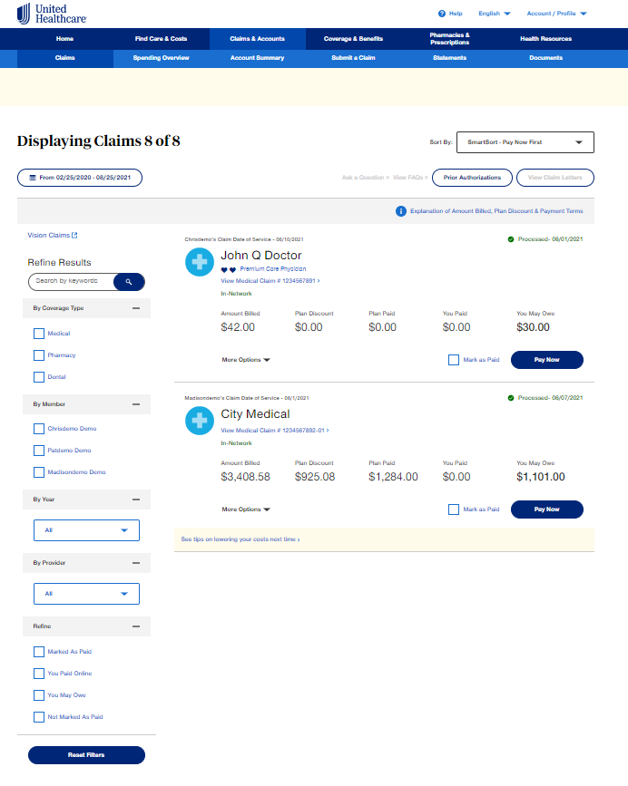

Claims & Accounts
Toolbar
Filter by dates of service or provider. View prior authorizations and claim letters.
Claim detail
Additional fitter options
Download claims into a spreadsheet
Notes:
On the Claims & Accounts page, you can access you and your covered dependents claims. Let’s look at the different sections on this page.
The toolbar takes you to different places within the Claims & Accounts page:
Spending Overview - Keep track of your medical spending. Knowing how much you spend may help you budget for future medical expenses during this calendar year.
Account Summary – View your plan balances such as your deductible and out-of-pocket maximum
Submit a Claim – If you have out of network benefits and saw an out of network provider, you can use this page to submit an online claim
Statements – This statement is a summary of benefit plan activity during a period of time.
You can use the side toolbar to filter down by covered member, provider and year. To view more information about your claim, click on “View Medical Claim” under the Provider’s name.
If you owe anything to the provider, you can make a payment right from this screen on the detailed claim page.

Slide 7
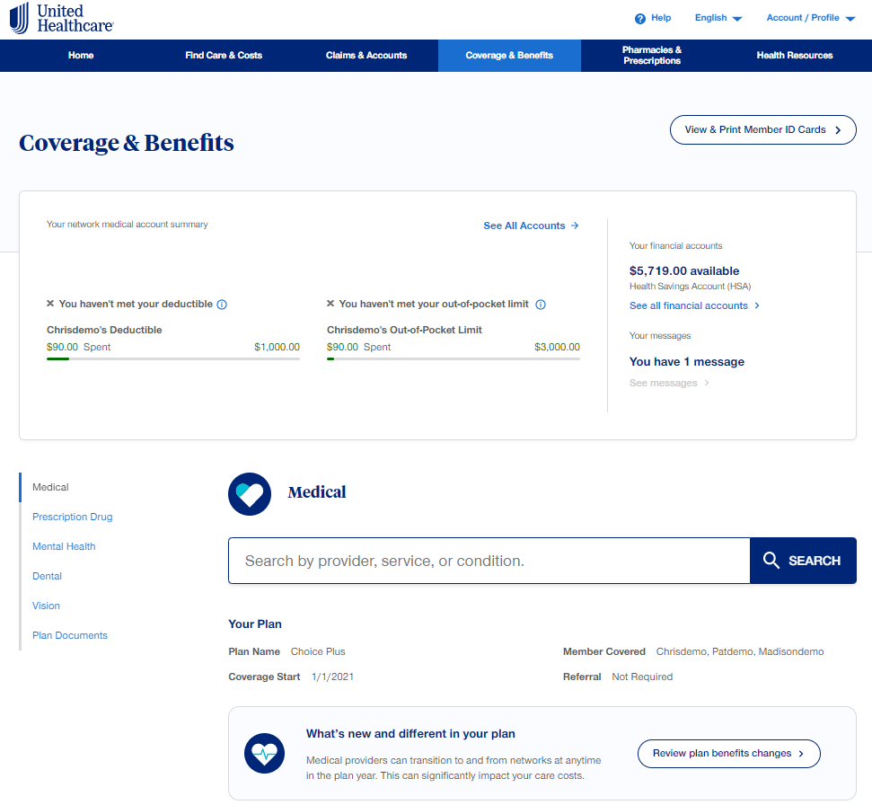
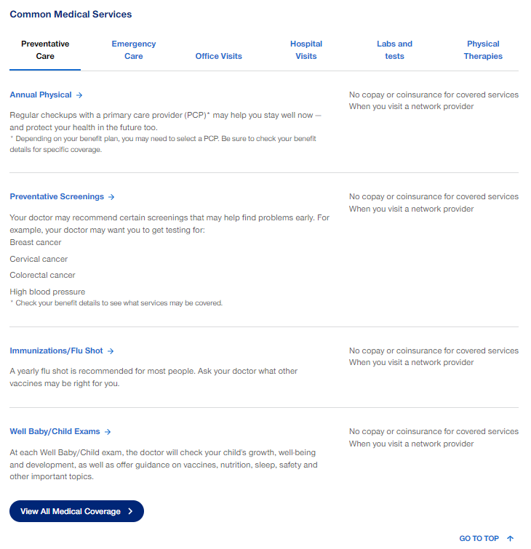
Coverage & Benefits
Notes:
The coverage & benefits page provides information on how common medical services are covered. You can view all medical coverage by clicking on the blue button on the bottom of this page.

Slide 8
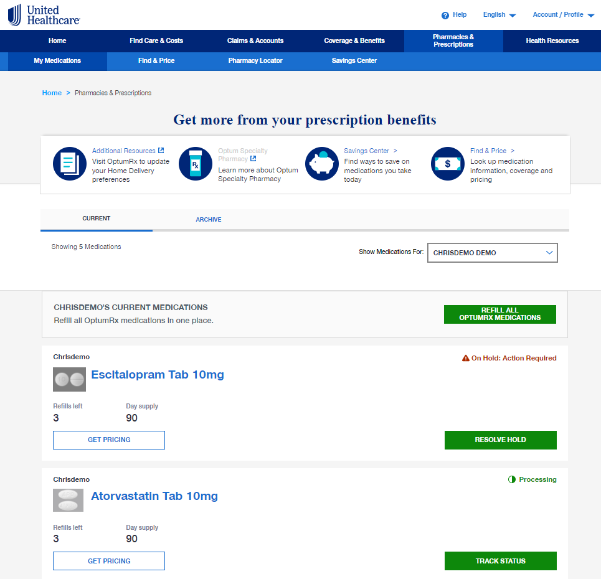
Pharmacy & Prescriptions
Toolbar
Virtual medicine cabinet
Quick view of current medications
Notes:
Now we are going to look at the Pharmacy & Prescriptions page. The toolbar gives you quick access to different pages within the Pharmacy & Prescriptions tab.
Under the toolbar is where you can view your virtual medical cabinet. By clicking on “Additional Resources” you can view and track current mail orders, sign up for mail order with OptumRx for your maintenance medications, set medication refill reminders and view your current medications, even those you pick up at your local pharmacy.
In the third section, you can click on “Get pricing” under each medication. This can be very helpful if you are in a high deductible health plan and want to save money by shopping around.
When viewing the medication on the next page, you can review the proper use of the medication, possible side effects and alternative medications, if applicable.

Slide 9
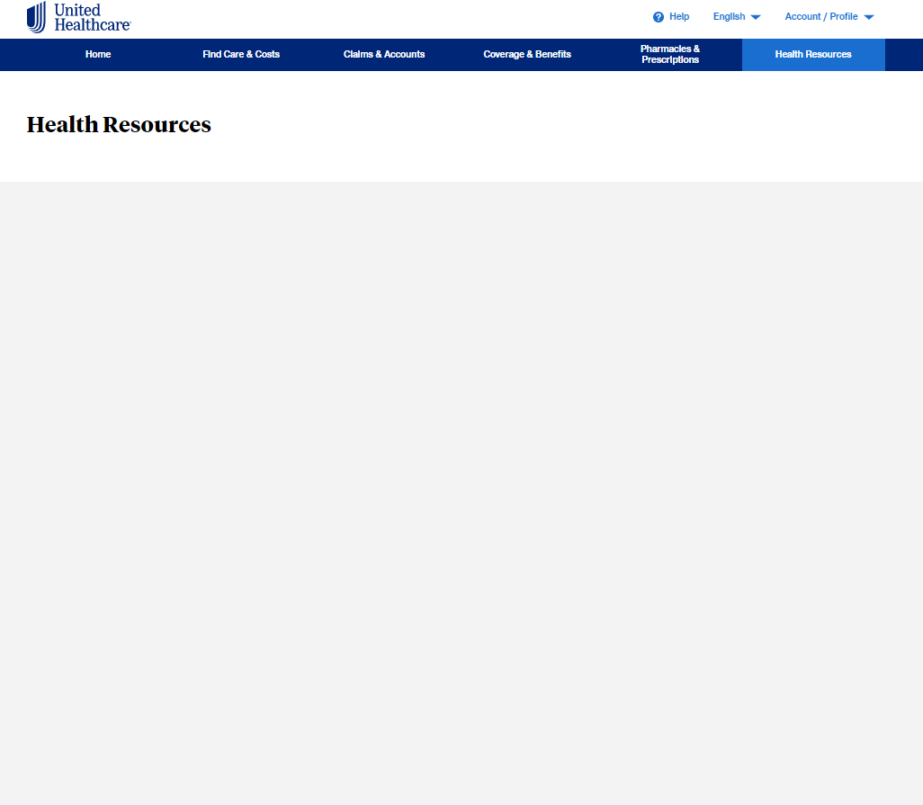
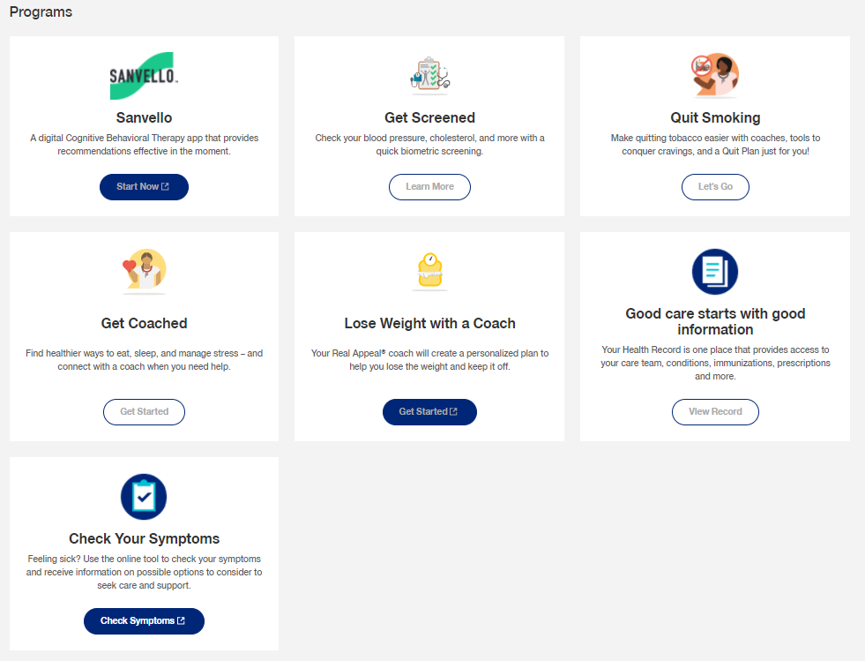
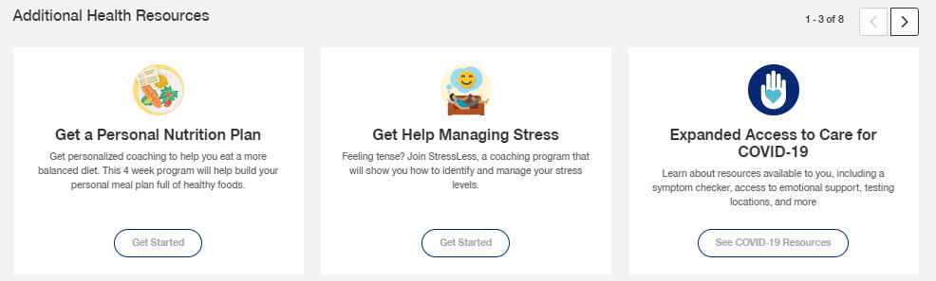
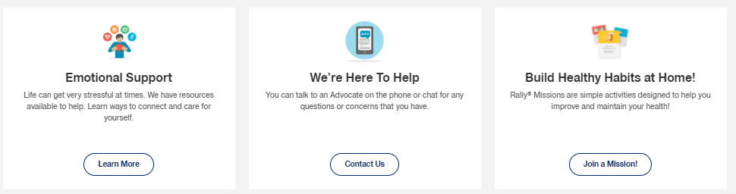
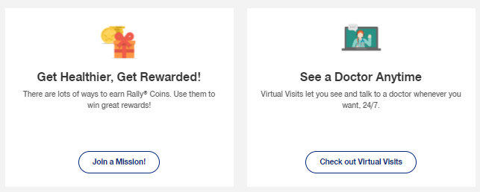
Health Resources
Notes:
As part of your health plan benefits, you can sign up for wellness programs and health support services under the Health Resources tab. Please note that some of the services featured on this page, may not be available. Login to your myuhc.com to see what is available to you at no additional cost.

Slide 10


UHC App
Download the UnitedHealthcare app
The UnitedHealthcare® app puts your health plan at your fingertips. Download it to:
Find nearby care options in your network
View and share your health plan ID card with your doctor’s office
Video chat with a doctor 24/7
Notes:
Get easier access to your health plan with the UnitedHealthcare® app.
• Find nearby care options in your network.
• Video chat with a doctor 24/7 — without leaving the app.
• See your claim details and view progress toward your deductible.
• View and share your health plan ID card.
The UnitedHealthcare® app is available for download for iPhone® or Android®.

Slide 11




Help is just a call away
Health plan questions? We’ve got answers.
Connect with our dedicated customer care team by phone or online:
Call the member number
on your health plan ID card.
Log in to myuhc.com®
and click on Call or Chat.
Tap into the UnitedHealthcare® app
for assistance when you’re on the go.
Notes:
Help is always just a call away.
If you have health plan questions, our experts are here to help with answers and guidance.
They can also help you with:
Understanding your benefits and claims.
Talking through your bill or payment.
Finding the right care and cost options for you.
Connect with a registered healthcare professional anytime by calling the number on your health plan ID card, logging into myuhc.com or downloading the UnitedHealthcare App.

Slide 12
Thank you.
Notes:
Thank you for listening. If you have any questions, please reach out to your HR Manager.

